Slide 1
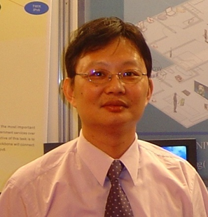
Web Hacking and Exploitation
教育部資訊安全人才培育計畫
資安實務專題講座
CTF搶旗大賽的重要資安實務技術
曾龍
btseng@mail.ksu.edu.tw
崑山科技大學
資工系暨數位生活科技研究所 副教授
雲端大數據分析暨資通安全研發中心 主任

Slide 2
Web Security
一場無止境的攻防

Slide 3
Web Security
資安情境
強化網站安全??

Slide 4
當然最重要的是
Secure Web Programming
原始碼檢測….
SSDLC…..
Web Application Firewall{WAF}

Slide 5
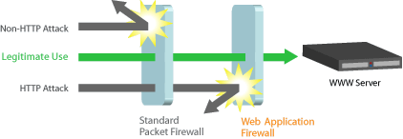
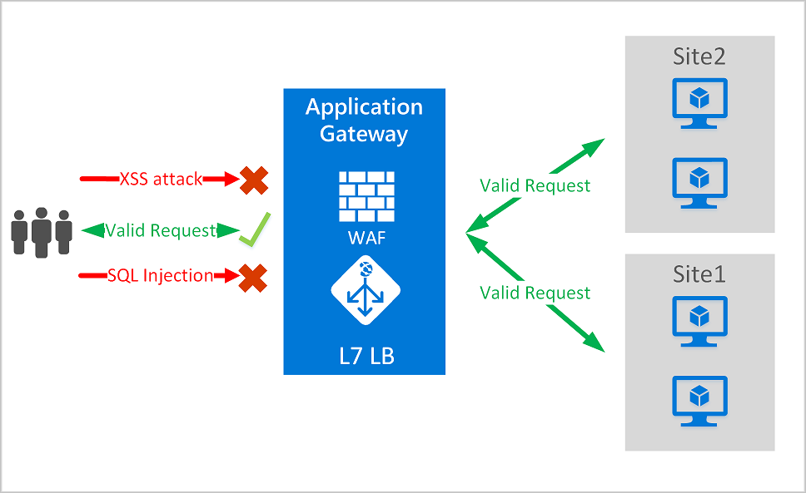


Web Application Firewall{WAF}
https://en.wikipedia.org/wiki/Web_application_firewall
A web application firewall (or WAF) filters, monitors, and blocks HTTP traffic to and from a web application.
A WAF is differentiated from a regular firewall in that a WAF is able to filter the content of specific web applications while regular firewalls serve as a safety gate between servers.
By inspecting HTTP traffic, it can prevent attacks stemming from web application security flaws, such as SQL injection, cross-site scripting (XSS), file inclusion, and security misconfigurations.
Nginx Anti XSS & SQL Injection
https://github.com/nbs-system/naxsi
(since 2002)
https://en.wikipedia.org/wiki/ModSecurity

Slide 6
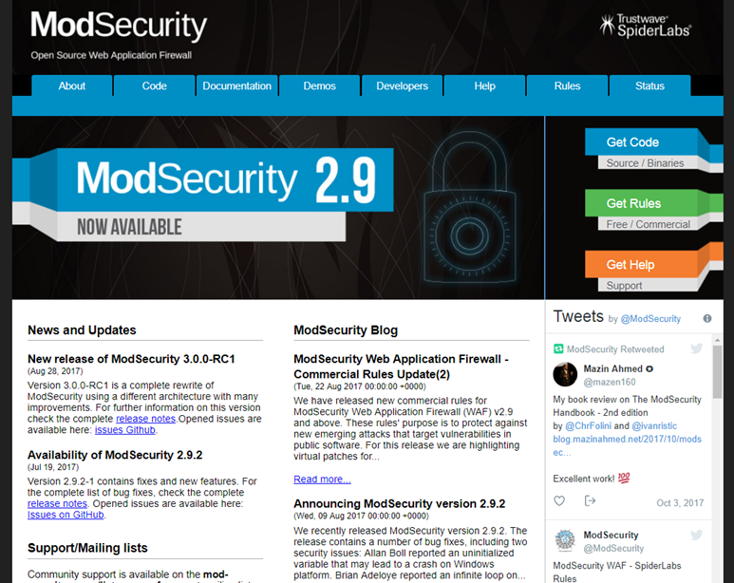
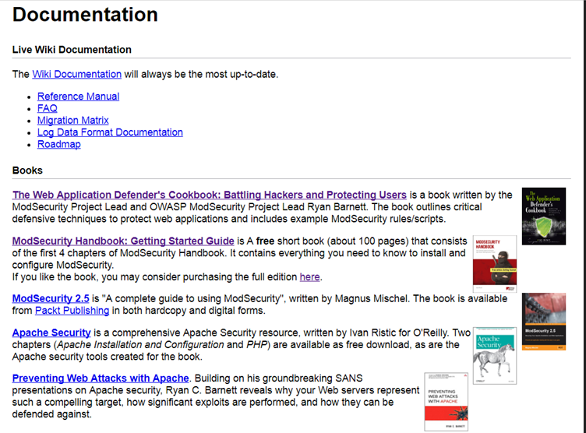
ModSecurity https://www.modsecurity.org/

Slide 7
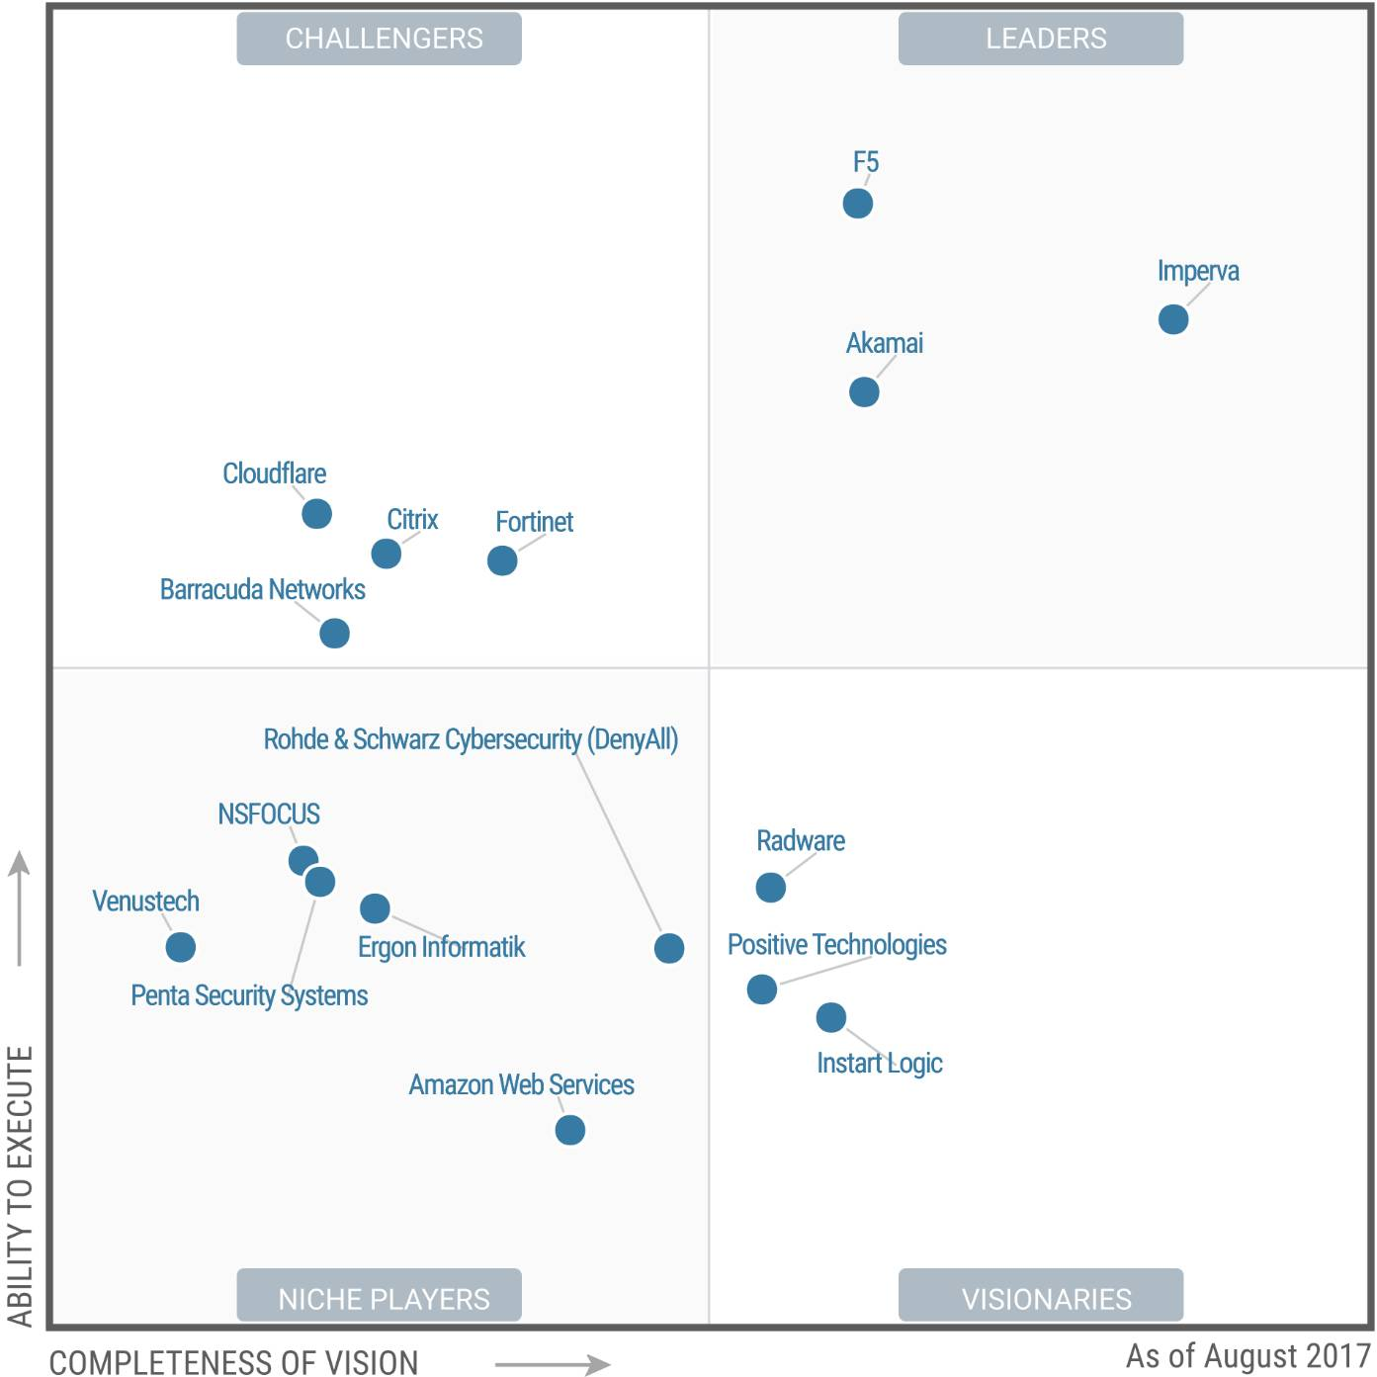

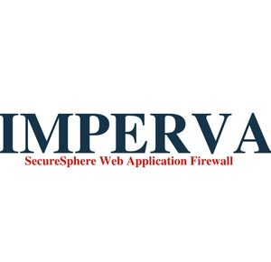

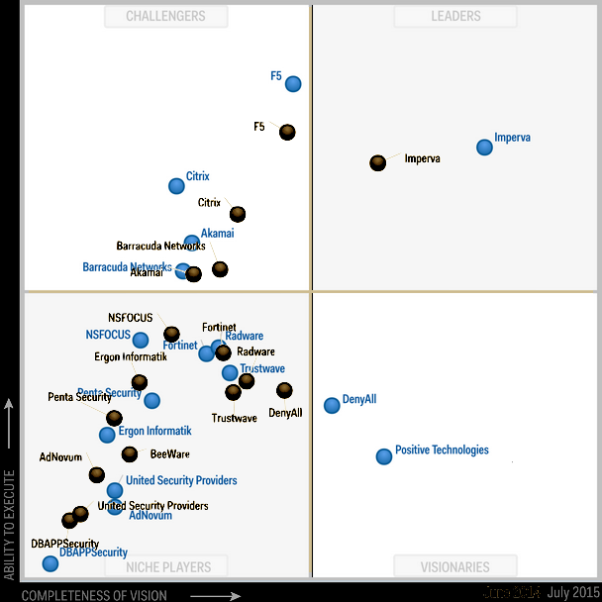
Commercial WAFs
Barracuda Networks WAF
Citrix Netscaler Application Firewall
F5 Big-IP ASM
Fortinet FortiWeb
Imperva SecureSphere
Monitorapp AIWAF
Penta Security WAPPLES
Positive Technologies PT Application Firewall
Radware AppWall
Sophos XG Firewall
commercial WAFs

Slide 8

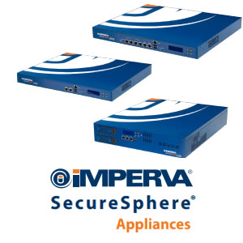
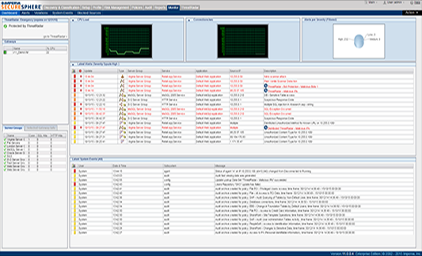

Slide 9
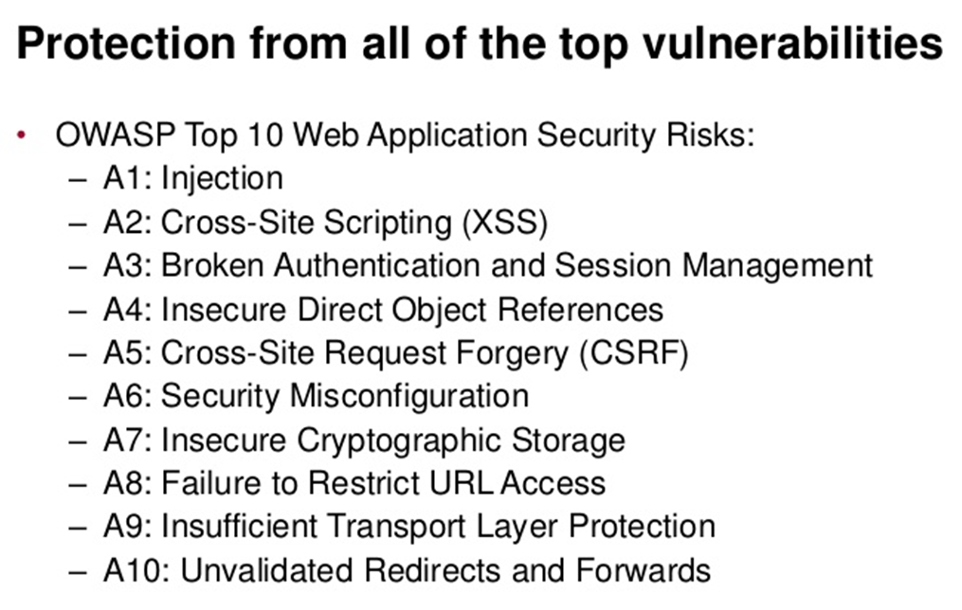
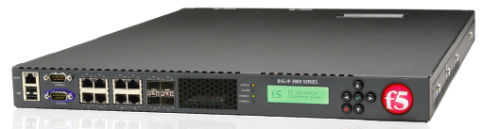
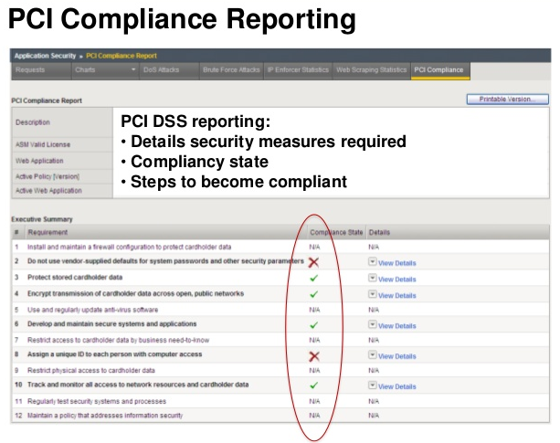
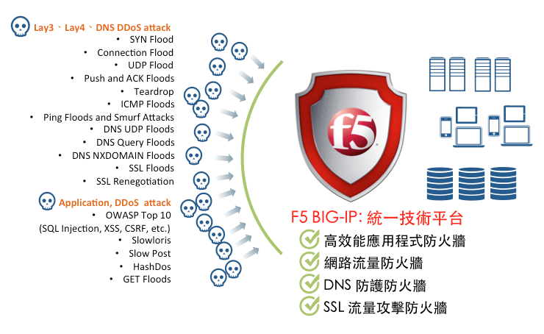

Slide 10
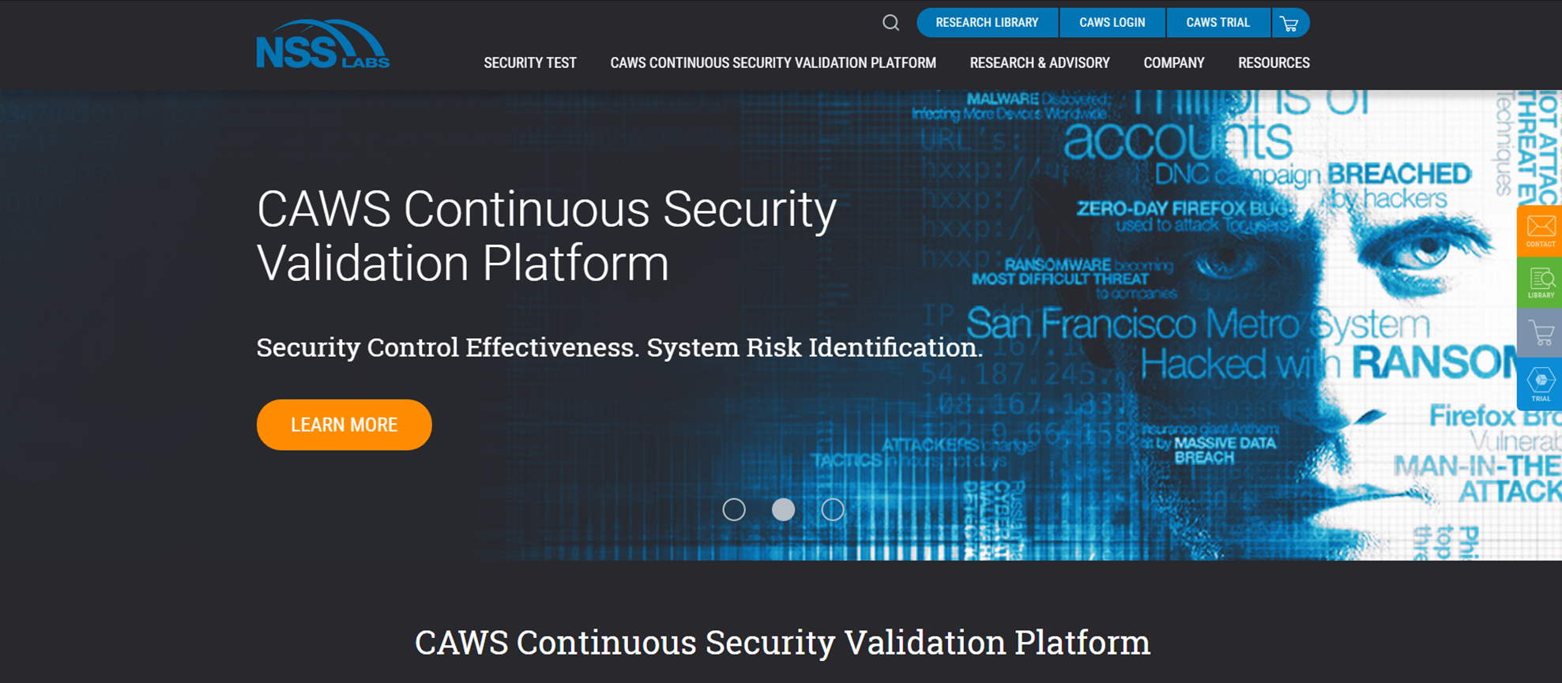
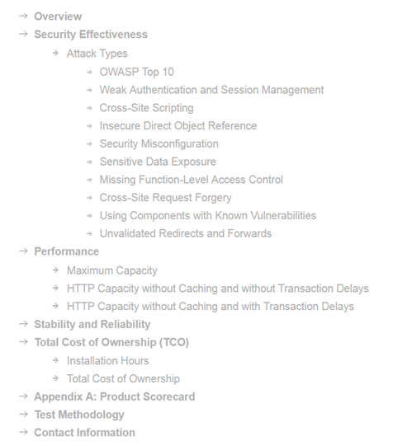
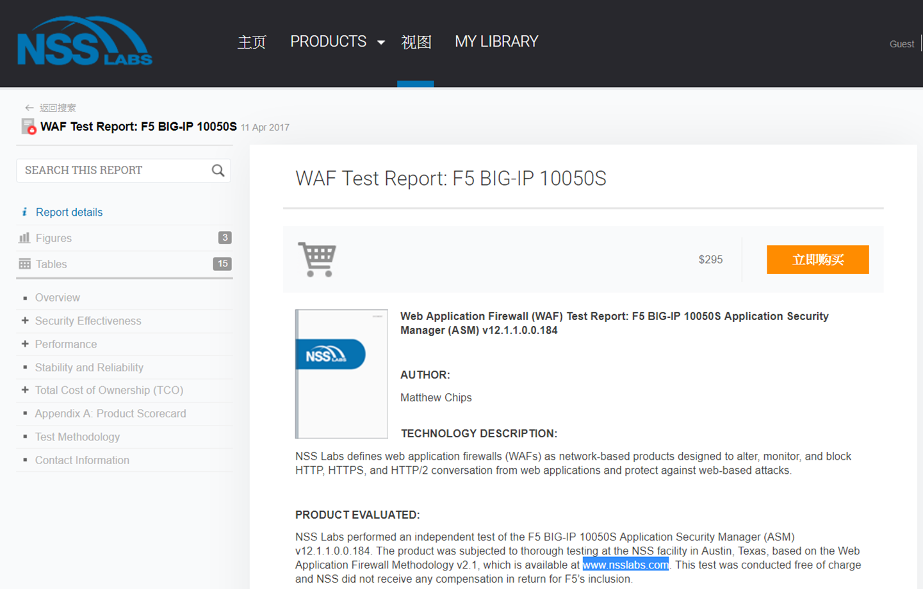
https://www.nsslabs.com/

Slide 11
Vulnerability
Web security Scanner

Slide 12

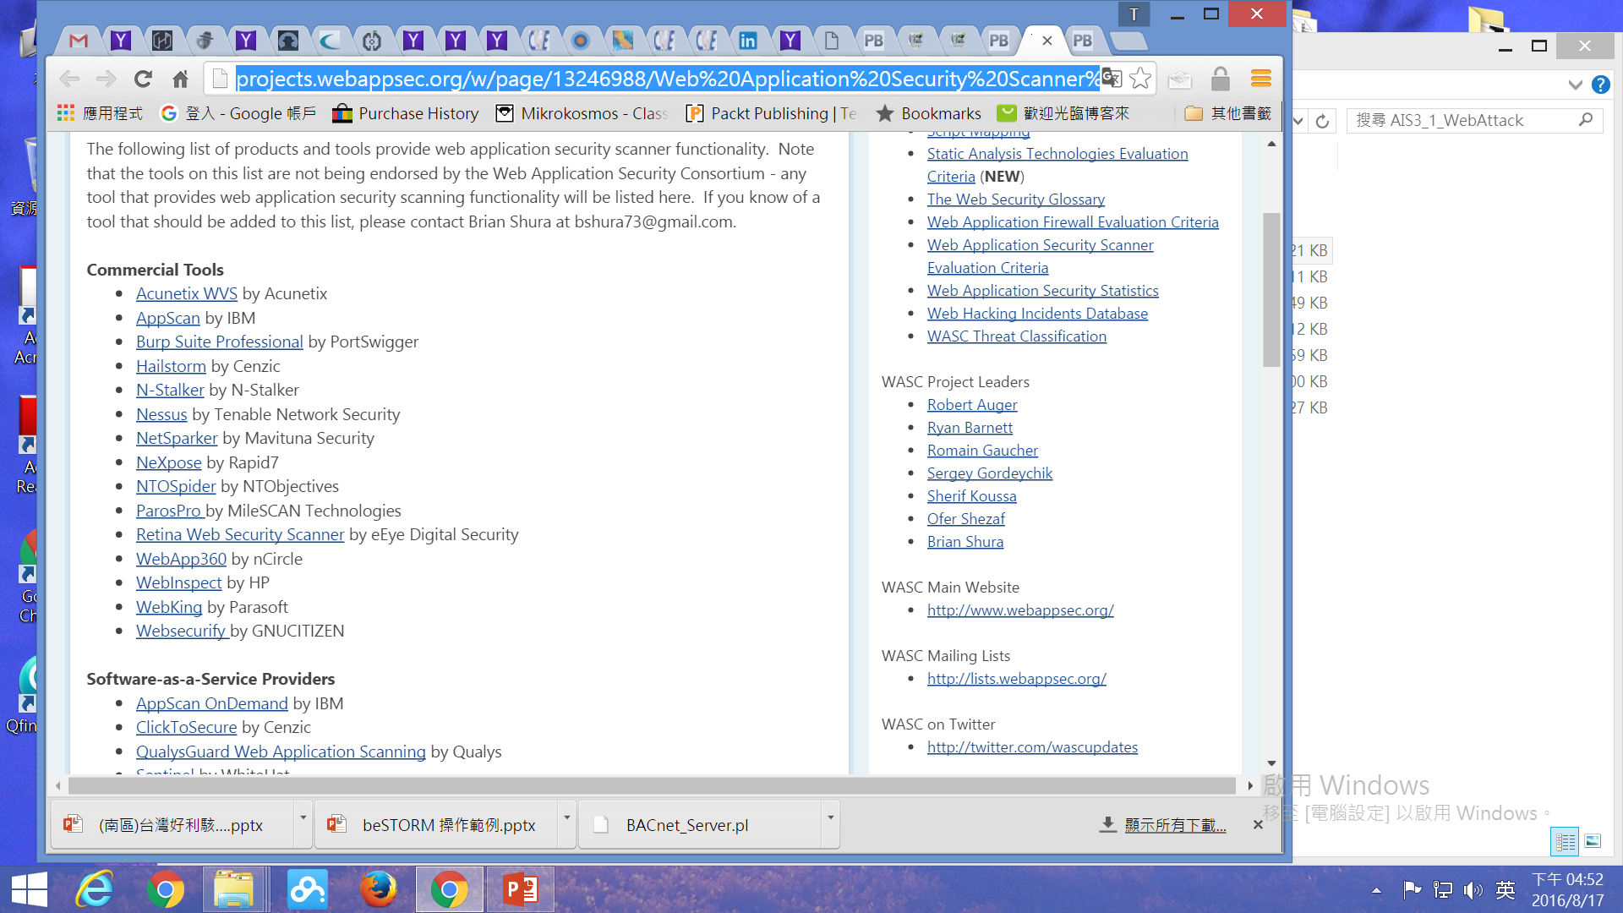
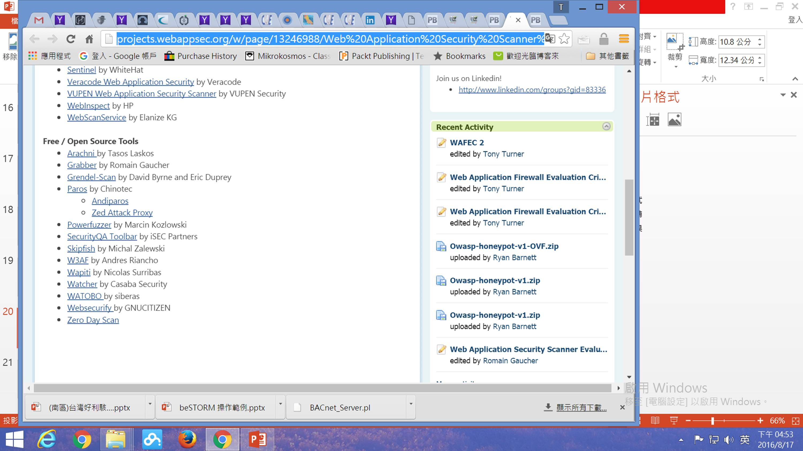


Web Application Security Scanner List
http://projects.webappsec.org/w/page/13246988/Web%20Application%20Security%20Scanner%20List
Software-as-a-Service Providers
AppScan OnDemand by IBM
WebInspect by HP
Sentinel by WhiteHat
ClickToSecure by Cenzic
WebScanService by Elanize KG
QualysGuard Web Application Scanning by Qualys
Veracode Web Application Security by Veracode
VUPEN Web Application Security Scanner by VUPEN Security

Slide 13

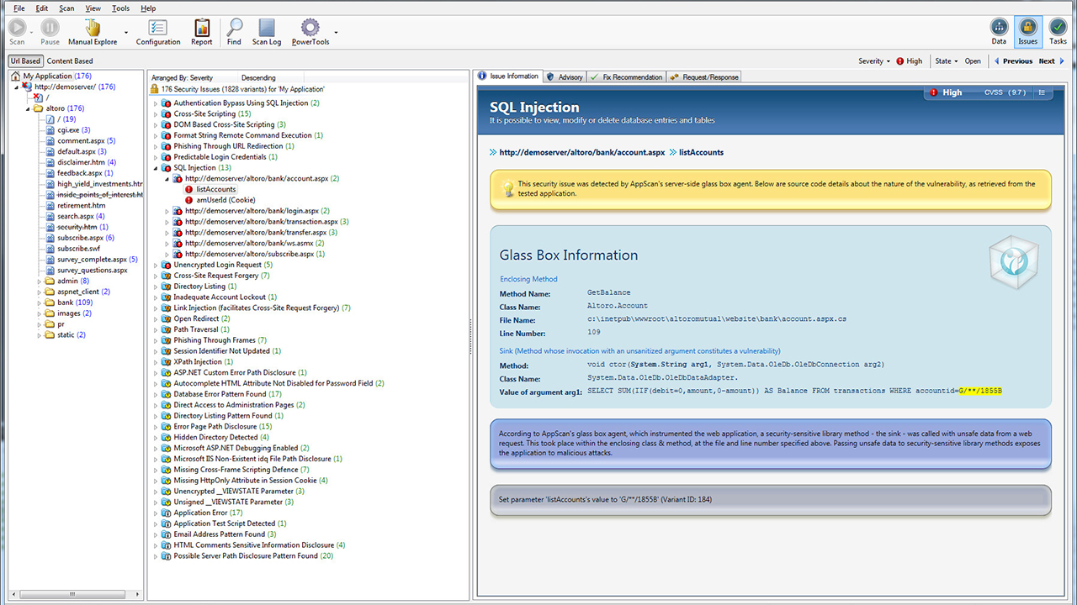

Slide 14

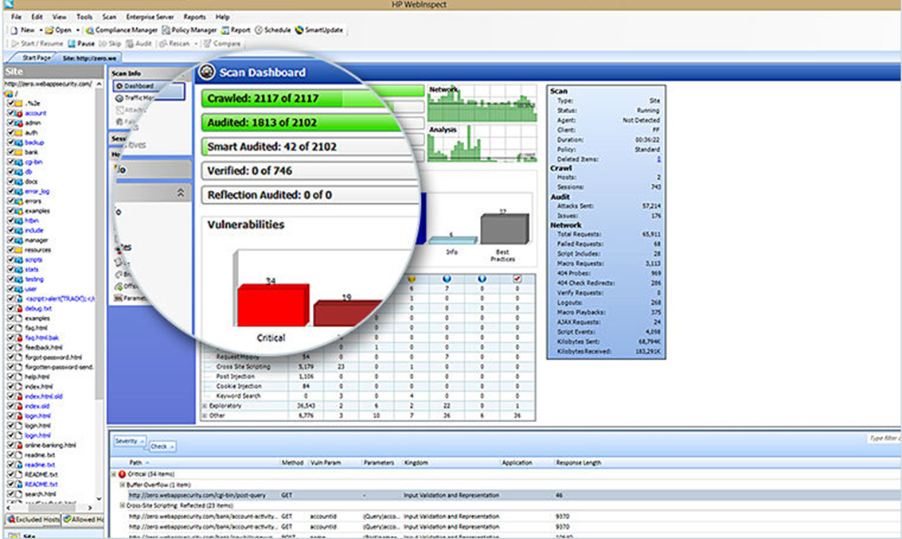

Slide 15
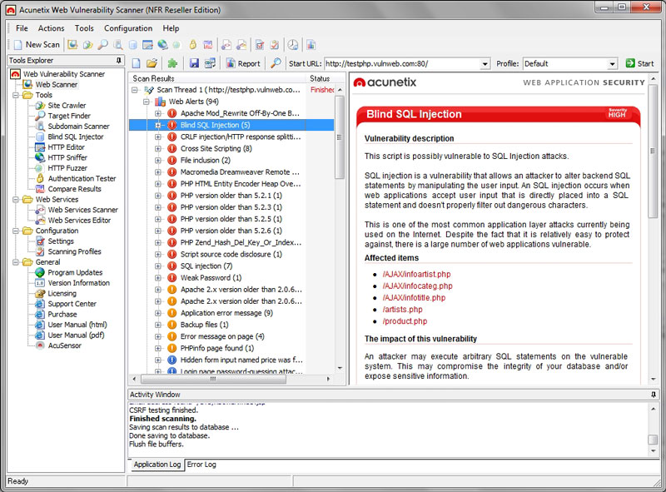

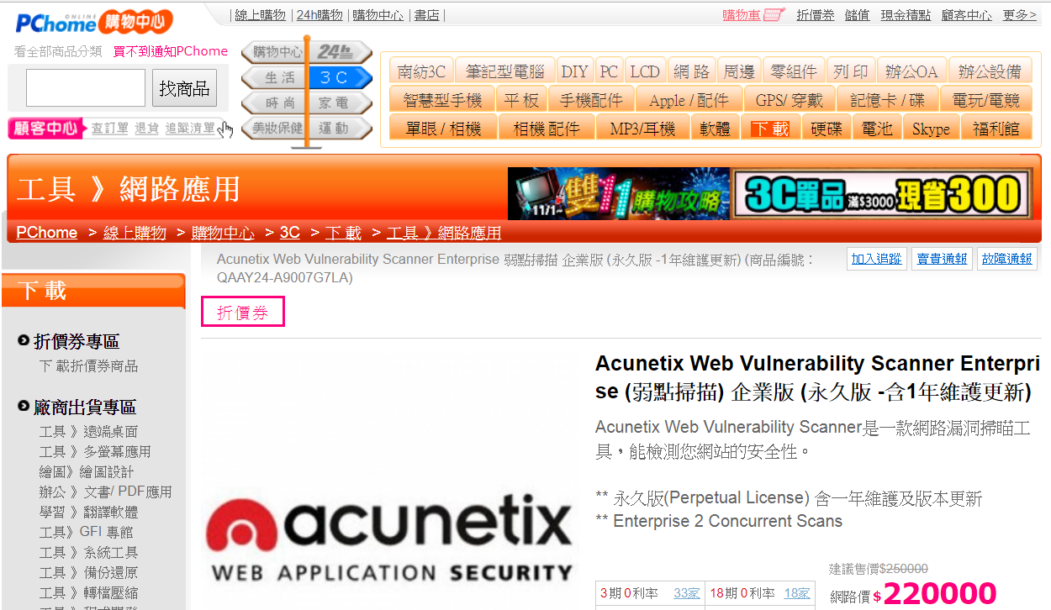

Slide 16
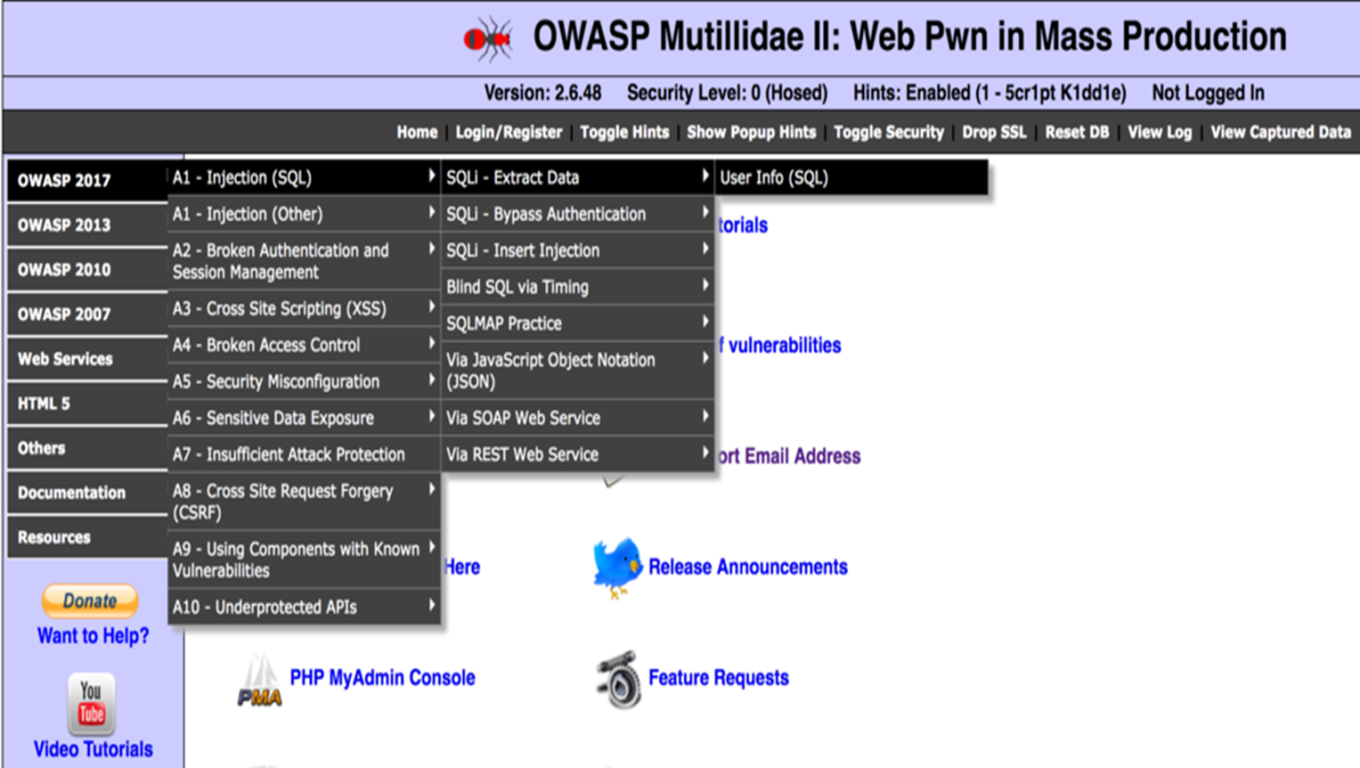



網站漏洞平台

Slide 17
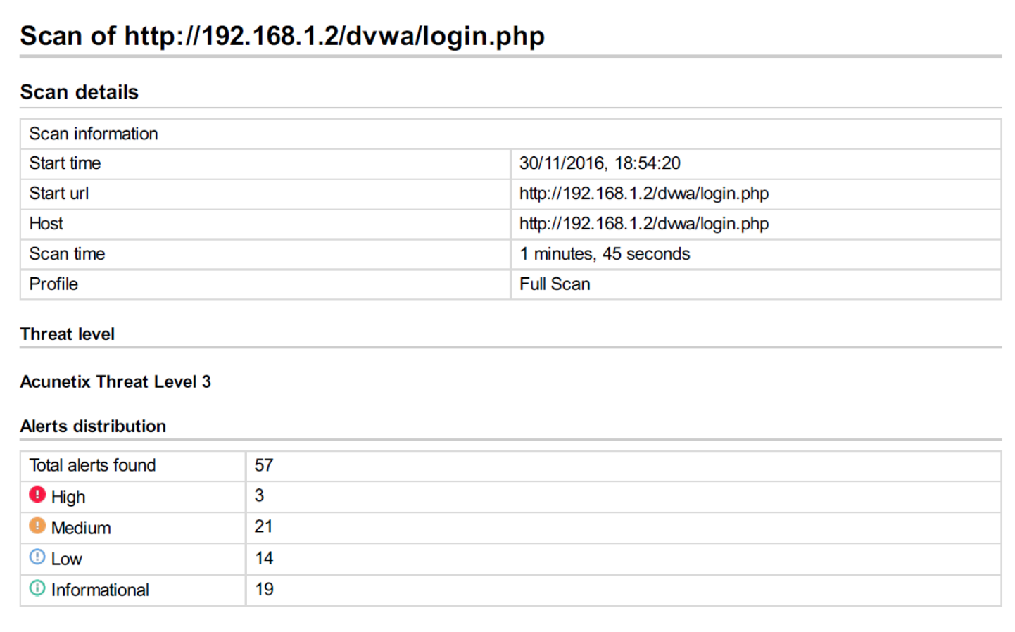
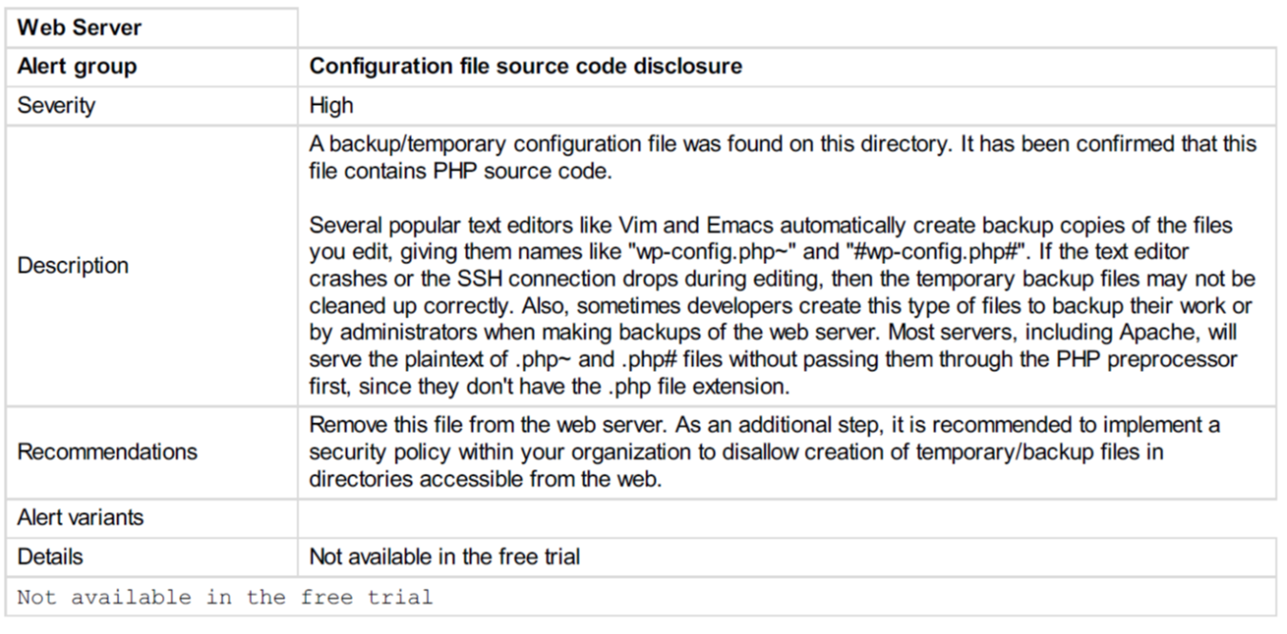

Slide 19
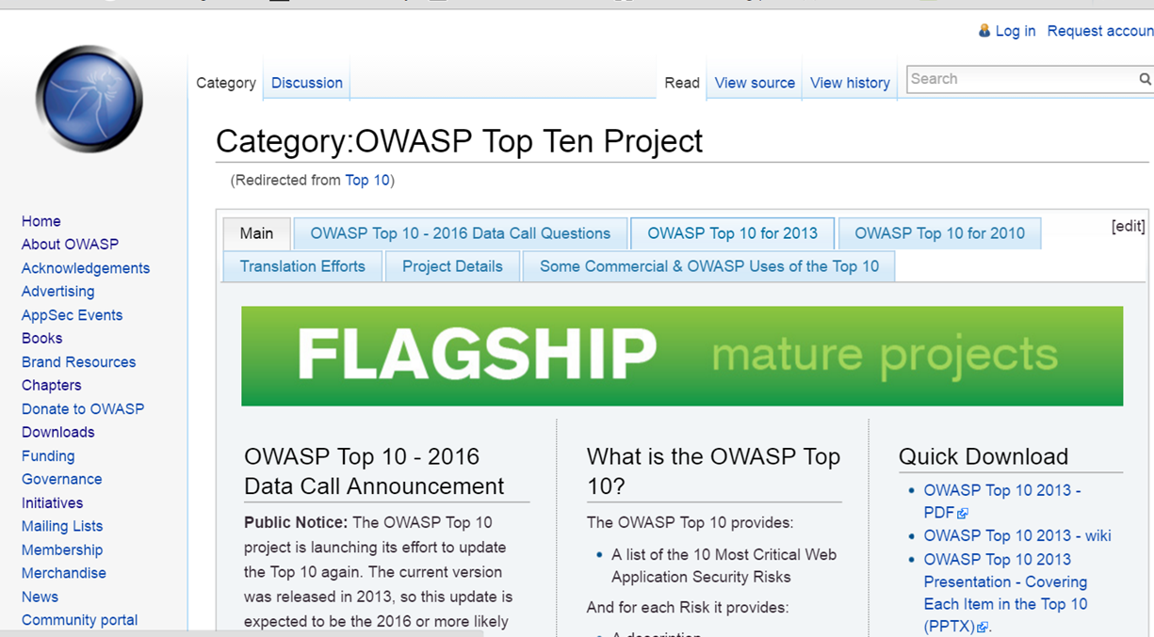
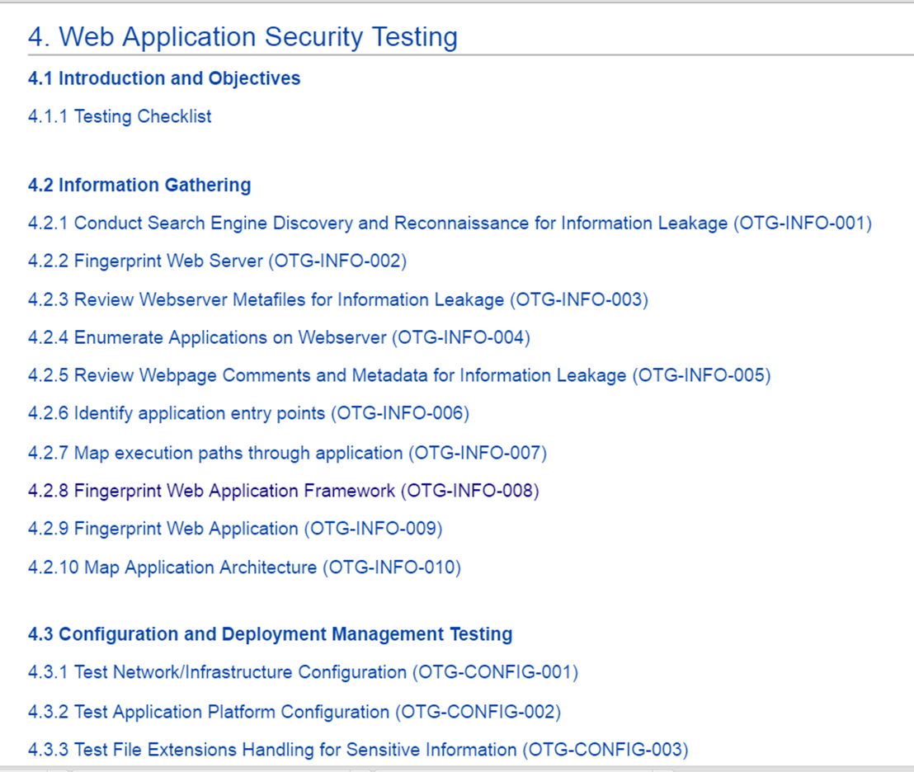
OWASP TOP TEN
https://www.owasp.org/index.php/Top_10
OWASP Top 10 - 2013
A1 | Injection
A2 | Broken Authentication and Session Management
A3 | Cross-Site Scripting (XSS)
A4 | Insecure Direct Object Reference
A5 | Security Misconfiguration
A6 | Sensitive Data Exposure
A7 | Missing Function Level Access Control
A8 | Cross-Site Request Forgery (CSRF)
A9 | Using Components with Known Vulnerabilities
A10 | Unvalidated Redirects and Forwards
https://www.owasp.org/index.php/
OWASP_Testing_Guide_v4_Table_of_Contents
19

Slide 20

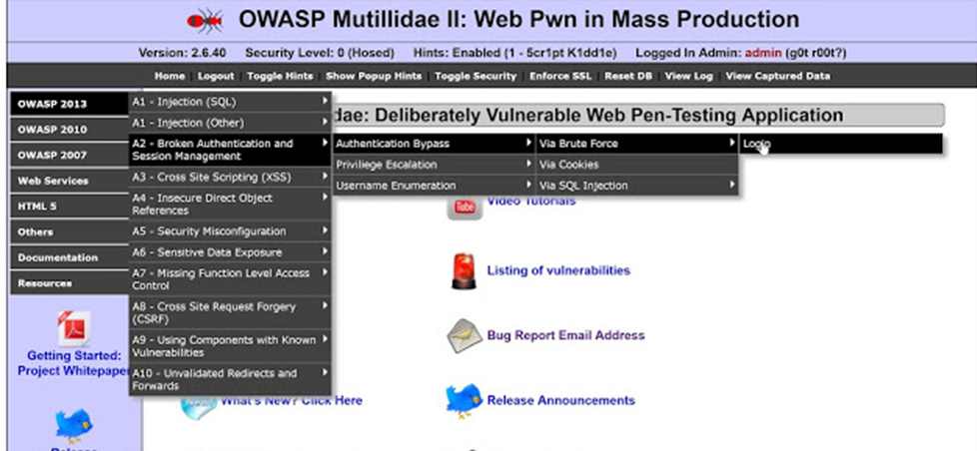
OWASP TOP TEN 實戰錄

Slide 21
Web Penetration Testing

Slide 22
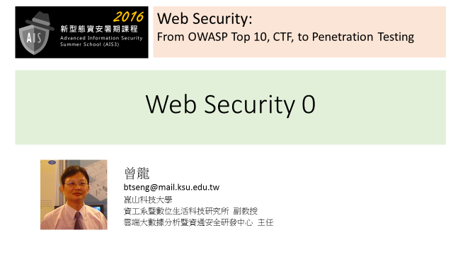
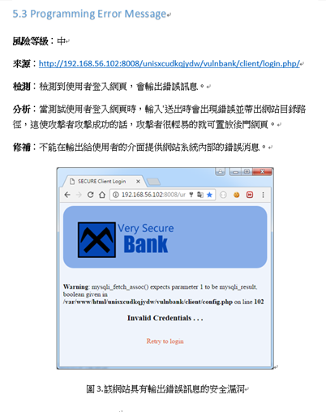
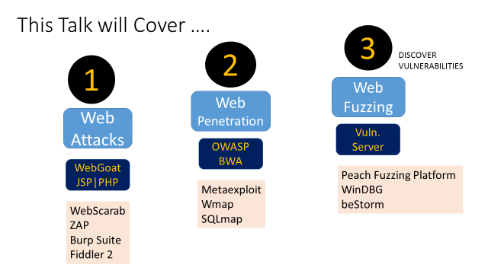

Slide 23
Learning WebSecurity

Slide 24
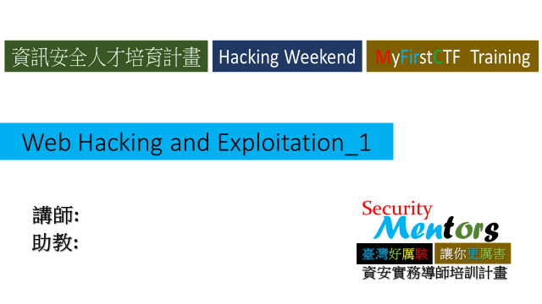
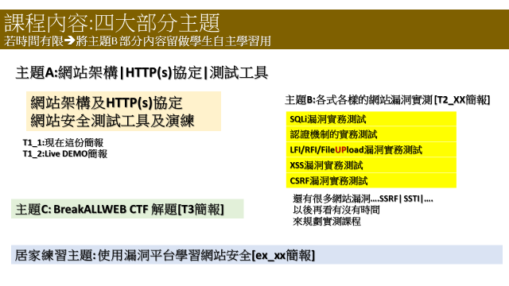
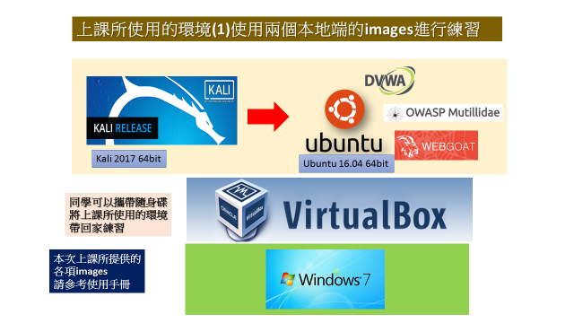
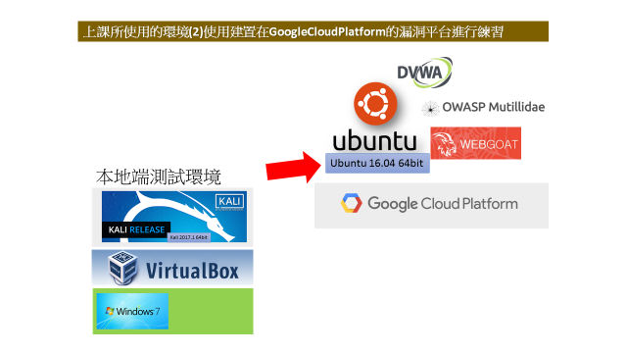

Slide 25
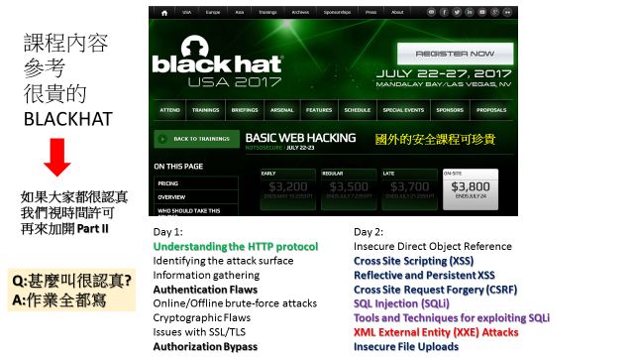
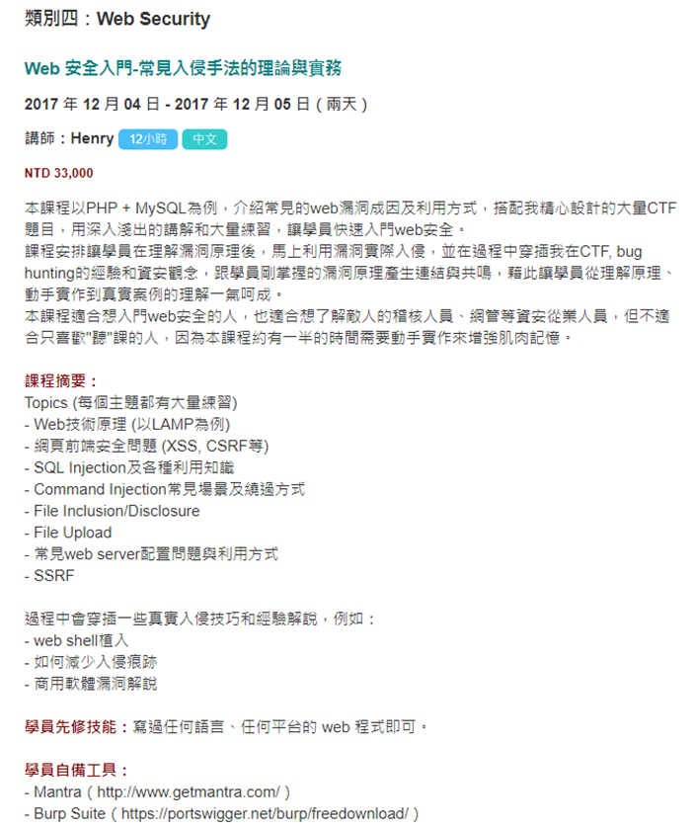
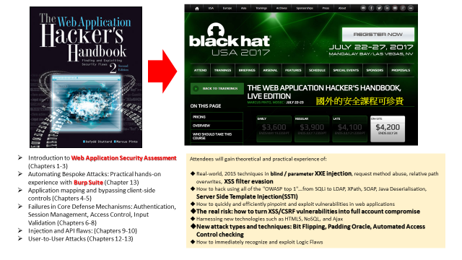
https://hitcon.kktix.cc/events/hitcon-winter-training-2017

Slide 26

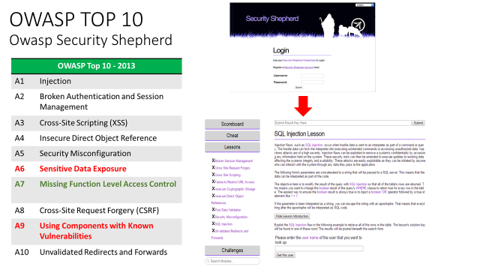
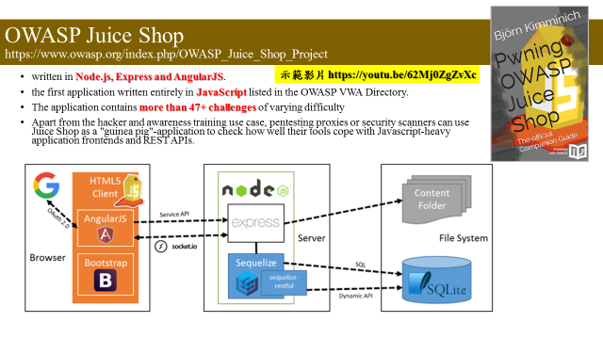

期中考

Slide 27
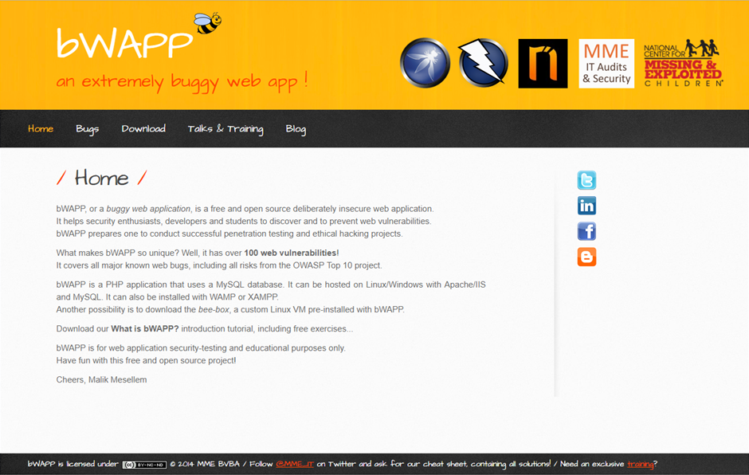
期末考
http://www.itsecgames.com/

Slide 28
網站構成與運作原理{HTTP協定}

Slide 29


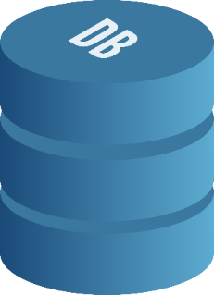
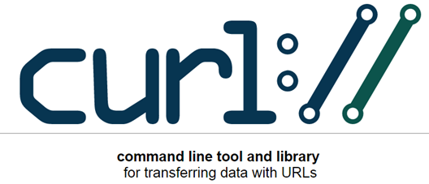


網站運作的主角
網站伺服器
Web Server
客戶端程式(Client)
溝通的方式
HTTP/HTTPS
協定(Protocol)
資料庫伺服器
Database Server

Slide 30

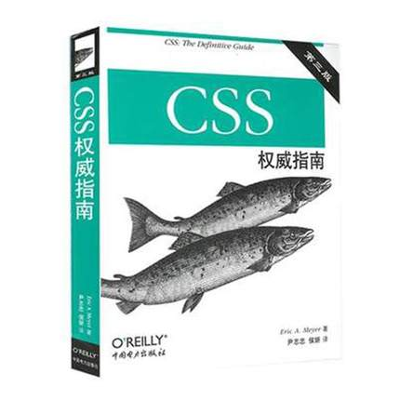
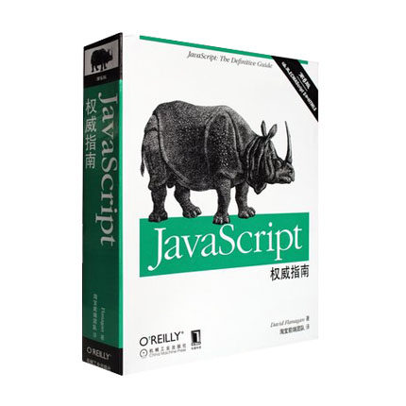
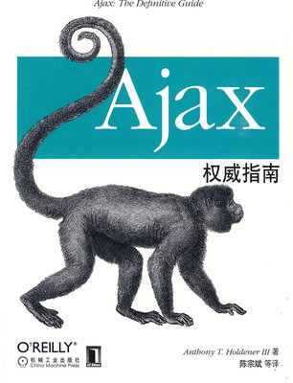
Web Client客戶端程式開發 在瀏覽器執行的程式

Slide 31
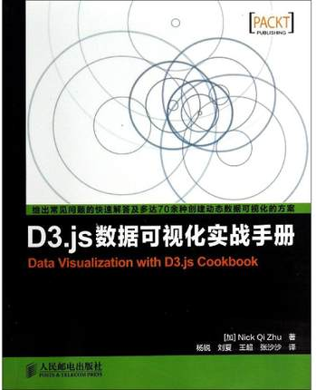



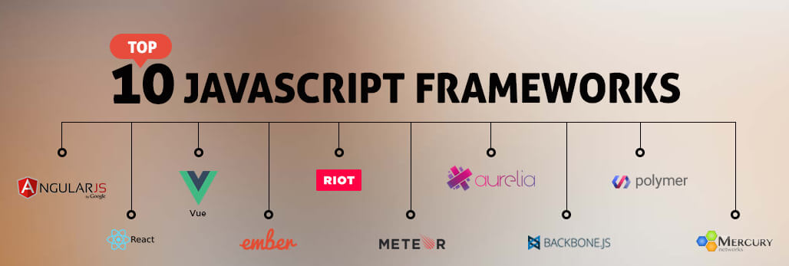
Web Client客戶端程式開發[有許多Javascript framework] 在瀏覽器執行的程式
JavaScript 框架大比拼：
Vue、React、AngularJS 與 Angular2 該用哪一個？
https://buzzorange.com/techorange/2017/07/31/all-about-javascript-framework/

Slide 32

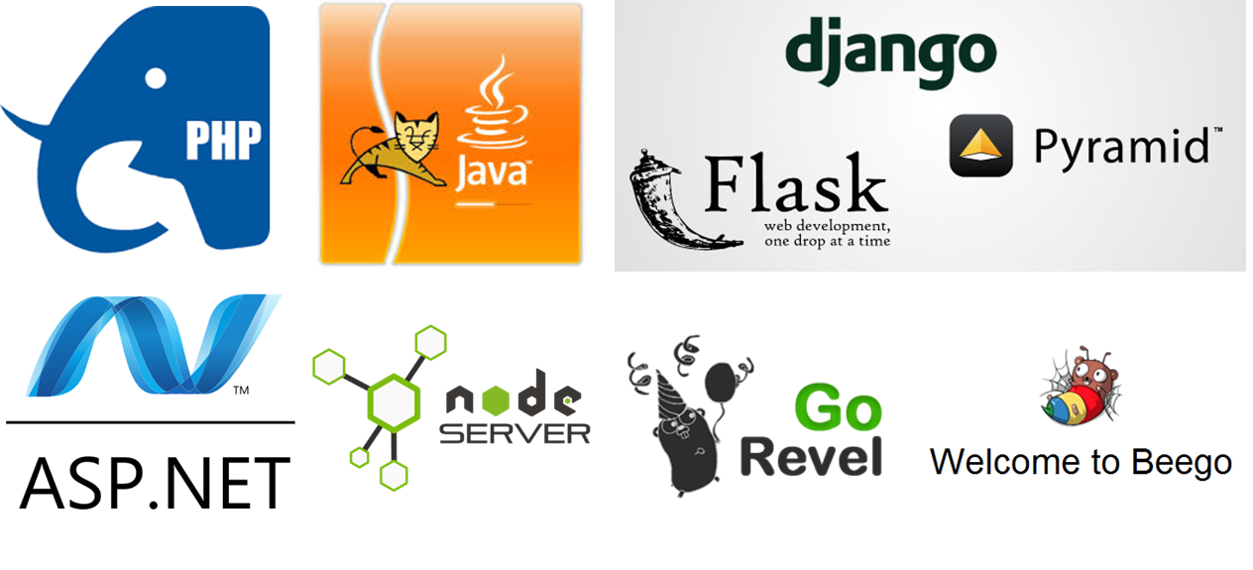
網站伺服器程式開發 有各式各樣的網站伺服器程式,…….

Slide 33

網站伺服器程式開發 有各式各樣的Web FRAMEWORK幫你快速開發一個網站

Slide 34



然後…….每年就有爆不完的漏洞
請自行製作簡報 你有興趣或正在開發的 進行漏洞測試報告
WordPress Security Scanner Tools
https://geekflare.com/find-wordpress-vulnerabilities/
1. WordPress Security Scan by Hacker Target
2. Detectify
3. WP SCANS
4. Security Ninja
5. SUCURI
6. Pentest-Tools
7. Exploit Scanner
8. WP Loop
9. WP Neuron
10. Acunetix
11. Quttera

